Slide 1
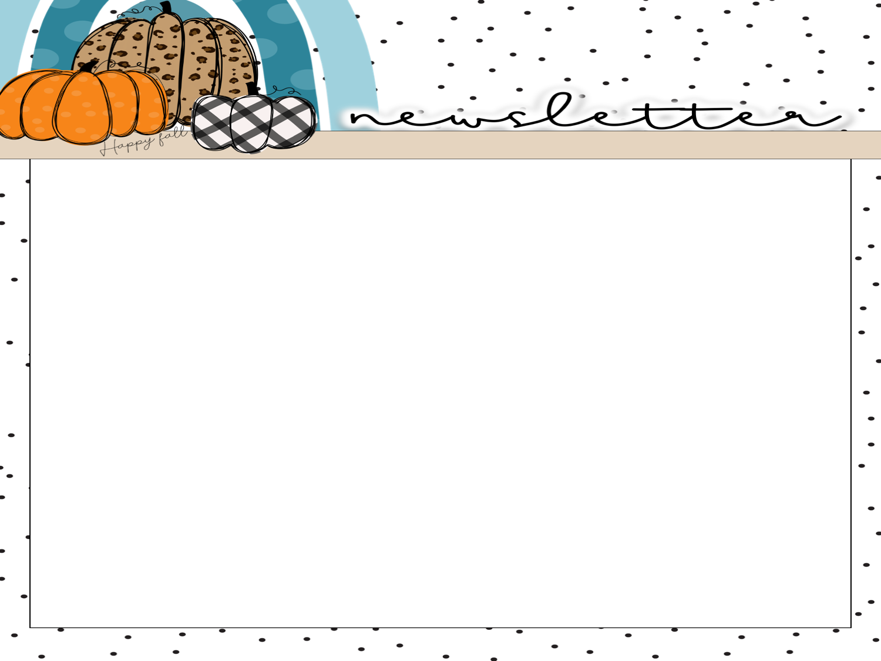
Mrs. peacock’s
Newsletter
OCTOBER 23-27, 2023
WEEKLY SKILLS
Coming up @ Northside
ELA: Text Features
PHONICS: Long E
LANGUAGE: Verbs
MATH: Finish 2- digit addition
SCIENCE: Animal Groups
10/23-10/27-RED RIBBON WEEK
Mon- wear red
Tues-wear tie-dye
Wed- wear wacky clothes
Thurs- wear fav. team jersey
Fri- CAREER DAY!
10/31- Trunk or Treat- students may wear appropriate costumes, no weapons or scary masks
Phonics Skill
Long E- e, ee, y, ea, ie, ey
WORDS TO KNOW –
Vocabulary
Tests & Homework
these
field
eat
we
lady
feet
key
three
sweet
windy
reach
play
were
most
very
could
always
who
about
too
Seed- it contains a very small, new plant
Leaves- part of a plant that takes in air and uses sunlight to make food
Roots- part of a plant that holds it in the ground and takes in water and minerals from the soil
Seedling- a young plant that grows from the seed
Pollen- a sticky, yellow powder inside the flower that helps make the seed
Life cycle- it show how a living thing grows, lives, and dies.
Cold-blooded- a kind of animal that cannot stay warm or cool on its own.
Warm-blooded- a kind of animal that can stay warm on its own
Vertebrate- an animal WITH a backbone
Invertebrate- an animal with NO backbone
Reminders
Please send a snack & water bottle with your child.

